Slide 1
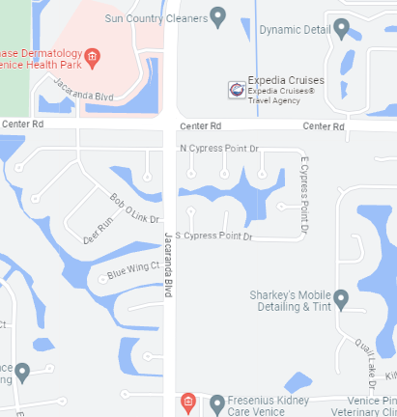
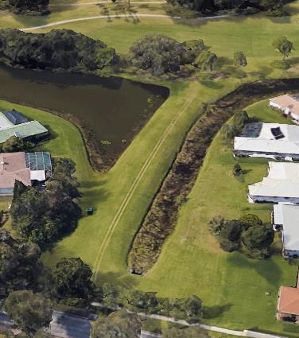
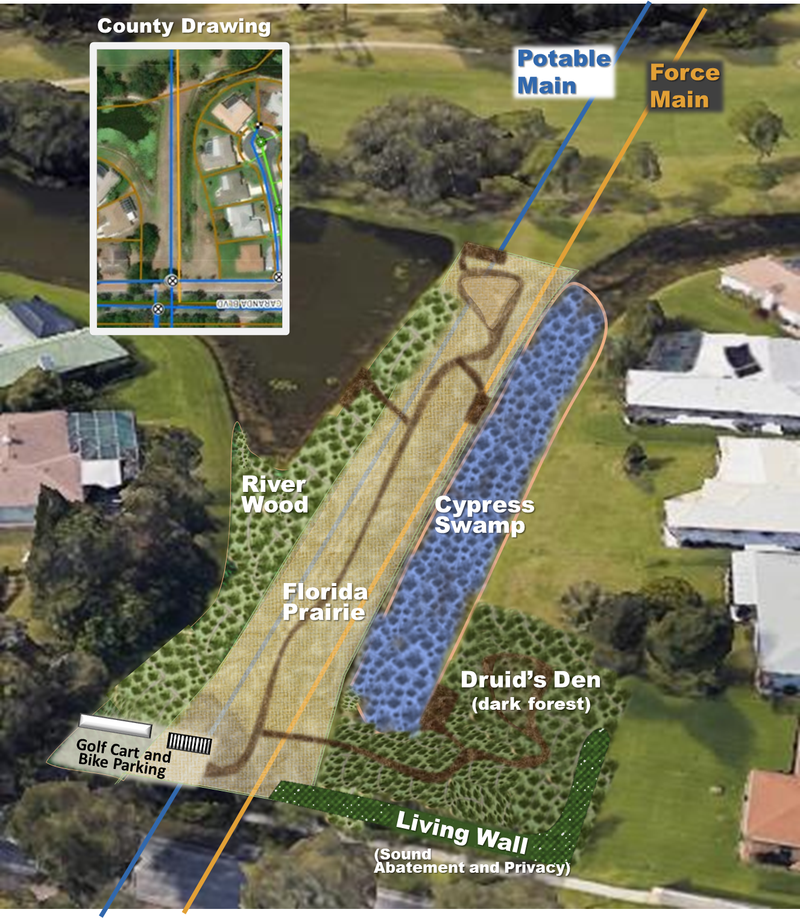
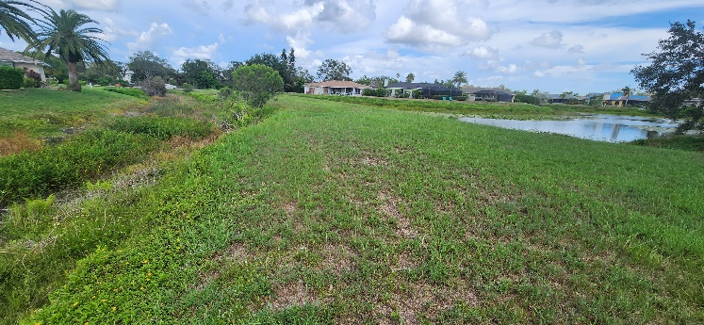
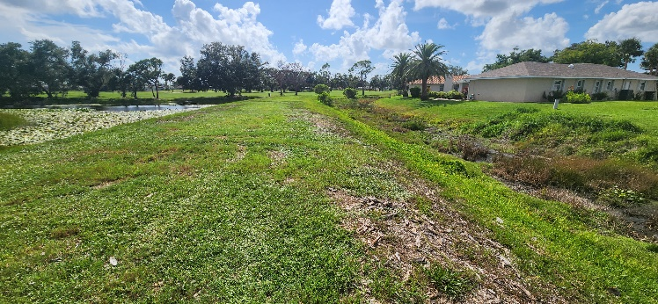
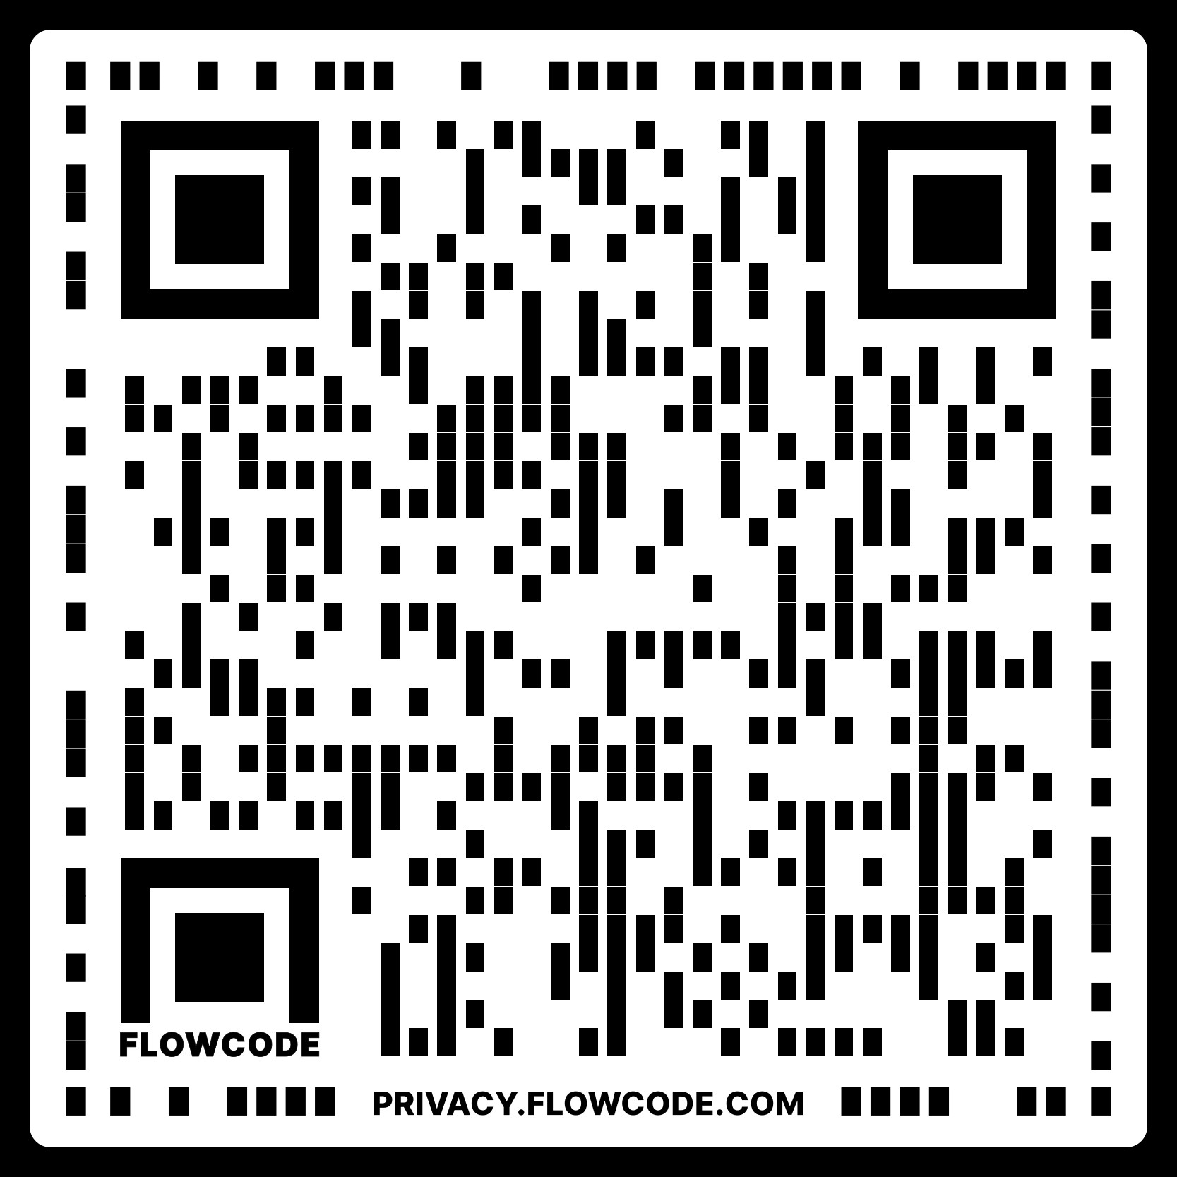
Jacaranda EcoPARK Fact Sheet
One-acre Ecological Restoration Area along Jacaranda
Accessible by sidewalk with bike and cart parking
Half mile of walking trails with sitting areas
Two forests, one wetlands, and one prairie
Designed for outstanding ecological benefits
Protects against flood, pollution, heat and wind,
Developed by Jacaranda West HOA
Center Road
One third of a mile
Jacaranda Blvd
Present Situation
Jacaranda
Eco-PARK
View from West (Golf Course)
View from East (Jacaranda Blvd)
(This mowed and watered turf will be replaced by beautiful no-maintenance forest)
Jacaranda EcoPARK details. The Ecological Restoration Area is a short walk south of Center Road along Jacaranda Blvd. The design and planting is being done by Suncoast Urban ReForesters (SURF), the reforestation arm of Florida Veterans for Common Sense Fund Inc. (suncoastforests.org). FLVCS Fund, Inc. is a nonprofit dedicated to increasing the Suncoast’s resilience to climate change – urban cooling, flood prevention, wind calming – by planting high-perform-ance microforests. The EcoPARK will be installed by volunteers from schools, churches, and interested organizations, supervised by experienced profes-sionals. Funds have been provided by the Jacaranda West Homeowner’s Association and several foundations. Additional tax-deductible donations are being collected from nearby businesses, organizations, and individuals who will use the park and benefits from its far-reaching ecological services. Please see the FAQ on the back for our leadership team
Visit a Microforest through a bird’s eye

Slide 2
Jacaranda EcoPARK FAQ
Who is developing the park? The Jacaranda West Homeowners Association is teamed with SunCoast Urban Reforesters (SURF), the reforestation arm of Florida Veterans for Common Sense Fund, Inc. Learn more about SURF or donate at www.suncoastforests.org.
SURF was founded by Florida Veterans for Common Sense, the Sarasota Bay Rotary Club, and Solutions to Avoid Red Tide (START) to plant forests throughout the Suncoast that will protect our region against rising temperatures, flooding, wind damage, and coastal water pollution. SURF has used its proven combination of Miyawaki planting strategies and Permaculture to create forests that have grown exceptionally fast in both Sarasota County (four) and Manatee County (three). The technical leader of this project is Dr. Charles Reith (charles.c.reith@gmail.com) – an urban forester and restoration ecologist – who may be contacted at 703-342-6185. The Property Manager isRhonda Sprague (sharithornton@gmail.com), who may be reached at 937-673-8032
What are the principal benefits of an eco-park at the designated location? The Park will restore many of the valuable ecological benefits of a natural forest to communities that presently suffer a lack of shade trees. This forest will provide cooler conditions, shaded walking, and wildlife viewing for visitors. Quite beyond that, the park will prevent flooding during intense storms and curb the transport of pollutants to the Gulf. Once the trees are large, they will also be valuable in calming potentially damaging winds and making the area quieter.
Will the park be available to everyone? Yes, the Park will abut the sidewalk along the west side of Jacaranda Blvd. There will be a parking area for bicycles and golf carts, plus simple trails and sitting areas to various corners of the park. The trails will not be paved but one trail will be wheelchair friendly for the full length of the property. We envision that this nature area will be enjoyed by people in all economic classes and circumstances.
How much will the park cost and how will the money be spent? We estimate that the Park will cost $50,000. It will also have a significant investment of volunteer work, including highly trained experts on such issues as irrigation and pathway design. The volunteer work can be considered a match to all funding raised. Our final budget will end up looking somewhat different from this because some materials are donated and some end up needing to be purchased. This is a conservative prediction, e.g., the actual budget should be less. The budget will include paid professional services from a locally hired small business (ZZ Designs) that has supported all prior microforests.
  $25K Plant stock
  $15K Plant selection, placement-design, site preparation, and supervision/safety of volunteer days (ZZ Designs)
  $ 2K Drip irrigation for plant establishment
  $ 2K Special soils and mulches, although we will seek donations for these
  $ 4K Hardscape materials for rock, shell, and supporting structural elements, again with donations in mind
  $ 2K Signs, bike racks, benches, and safety rails, again seeking donations before buying.
How much has been raised so far on the Jacaranda EcoPARK and from whom? $21,000 of the anticipated $50,000 has been raised. $10,000 was pledged to get the project started by the Jacaranda West Home Owners Association. Another $10,000 was pledged by the Gulf Coast Community Foundation. Finally, the Rotary Club of Sarasota Bay has donated $1000.
When will the park be constructed? The development of the park is a multistep process that starts with 1) preparing a mulch bed out of cardboard and recycled wood chips, 2) proceeds with a six-week incubation period, 3) engages professional work to order and receive plants from as many as five local nurseries and drill special holes into which volunteers will install plants and, 4) that ends with a big volunteer day when as many as 100 people will come out under the supervision of our paid professional and Master Gardeners to install 70 or more species of native plants of all shapes and sizes. If our fundraising goes well, we will perform Step One (Mulching Day) in January and then plant the forest in March.
Will the forest require maintenance? Not much; an important benefit of the forest is that the noisy, expensive, and environmentally damaging mowing and fertilization will no longer be necessary. Our forest and prairie (see below) are natural habitats that have been “rewilded” using native plants so they quickly become maintenance-free. However, all our plants will benefit from some nurturing, especially temporary irrigation, at the beginning. A few fallen trees might need to be staked up but after a year or two the forest will be a fully native, maintenance-free feature on the local landscape. The trails will be maintained by the Jacaranda West Home Owners Association.
Aren't there big pipes running underground there, running from the water treatment plant to the golf course and Jacaranda W community? Yes, there are, and the team is working very closely with the County to make sure that our project does not limit the County's ability to access these pipes in the unlikely circumstance that one or the other fails and needs to be repaired or replaced. To avoid a future conflict and prevent any trees from having to be removed, the planning team will establish perennial prairie over those pipelines. Forests are valuable but so are prairies because they also play an important role in preventing flooding and purifying water, and in harboring special forms of wildlife such as pollinating bees and butterflies, as well as seed-eating birds. Suncoast residents presently must drive south to Lemon Bay or inland to the Myakka Park to see a really good Prairie but this will be a small, beautiful and educational prairie right here in the middle of our neighborhood.
What else should I know about this Park? The Park will use the planting method that SURF has developed and successfully deployed at seven fast-growing forests so far extending from Ellenton down into South Palmer Ranch. The method is a merger of a Japanese planting strategy called Miyawaki with a soil management regimen that is associated with permaculture, an organic, agroforestry planting discipline. The remarkable benefit of this methodology is that the forests grow extremely fast thanks to the close plantings of many different native species. These foster shade competition, which experience has shown inspires plants to grow up to ten times faster than they would otherwise. The signature of a Miyawaki forest is to grow into 100-year forest in just ten years. The benefit of this fast growth is not only that you get a mature forest very quickly, but also that you enjoy remarkable ecological benefits from the beginning and then continuously for generations.

